Slide 1
Federated Learning

Slide 2
What is Federated Learning?

Slide 3
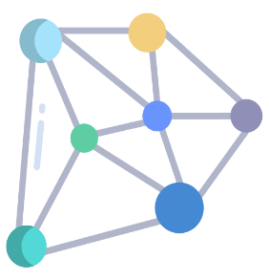






Conventional Deep Learning
All the data is reveal to a third party
to perform learning
In conventional deep learning …
Sensitive information, such as the personal information of the patient in the medical data, may be leaked out through this third party
Data owners have no control over the learning objective
The learned model is not available directly to data owners
data
data
data

Slide 4
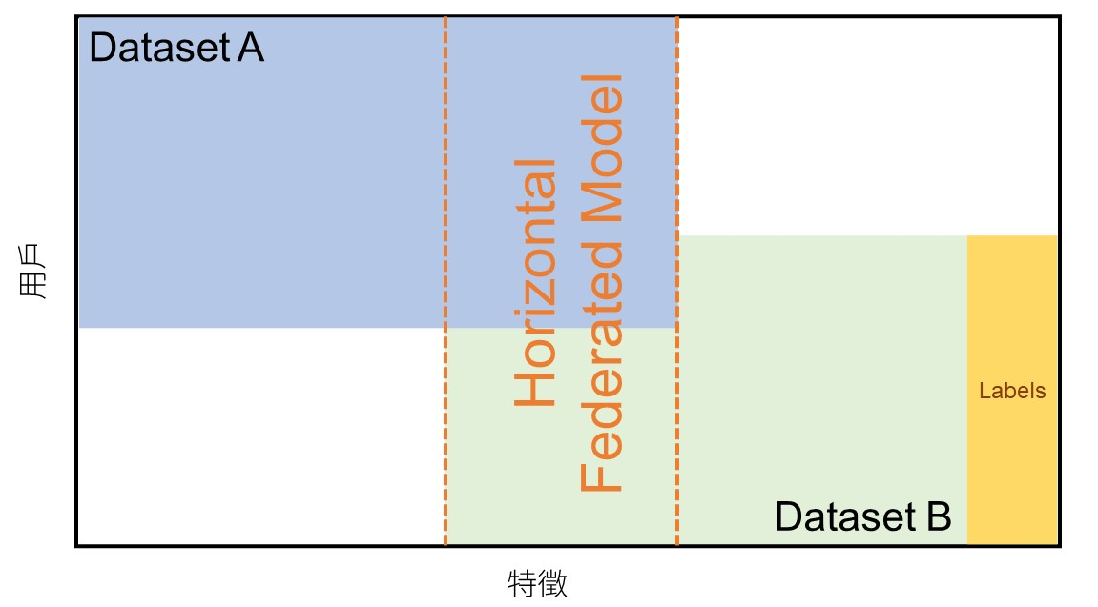
Federated Learning (Horizontal)
Horizontal federated learning is suitable for:
user features of the two datasets overlap a lot
but the users overlap little
Notes:
feature類似 用戶不同

Slide 5


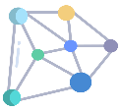


Federated Learning (Horizontal)
Aggregate
parameter
data
parameter
Private Data
Local Model
data
gradients
gradients
Local Model
Private Data
parameter
data
gradients
Private Data
Local Model
Notes:
多一兩頁去做vertical

Slide 6
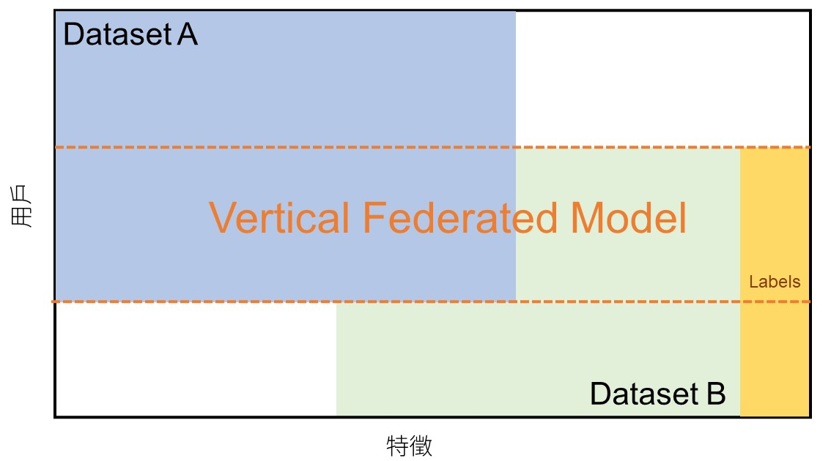
Federated Learning (Vertical)
Vertical federated learning:
user features of the two datasets overlap little
but the users overlap a lot
Notes:
用戶類斯 feature不相同

Slide 7

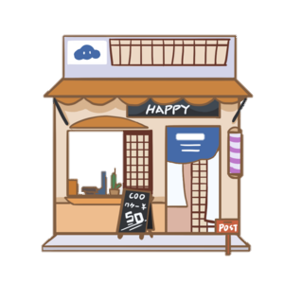
Federated Learning (Vertical)
Encrypted entity alignment to identify users
Public key
Aggregate
gradients
Public key
data
gradients
Private Data
Local Model
data
embedding
embedding
Public key
Local Model
Private Data
Encrypted entity alignment to identify users
gradients
data
embedding
Encrypted entity alignment to identify users
Private Data
Local Model
Notes:
多一兩頁去做vertical

Slide 8
Assumptions – Honest-but-Curious Clients
Honest
All participants will follow the data confidentiality rules of Federal Learning
Curious
All participants will also use all the information they obtain to infer the data information of other participants
but

Slide 9
Privacy-Preserving Deep Learning
Reza Shokri and Vitaly Shmatikov
Proceedings of the 22nd ACM SIGSAC Conference on Computer and Communications Security (CCS’15)

Slide 10
Method - Distributed Selective SGD (DSSGD)
Server
Participant
Server
When uploading, each client selects at most θ_{u} (θ_{u} set by the client) gradients after one epoch according to one of the following criteria:
Largest Values: Sort gradients and select starting from the biggest.
Random with Threshold: Randomly subsample the gradients whose value is above threshold.
global parameter
The server adds the uploaded gradient value to the corresponding global parameters, and updates the counter stat for each parameter.
This counter can help clients obtain from the server the most frequently updated values of the parameters with the largest stat values.
Upload gradients
Local training

Slide 11
Method - Distributed Selective SGD (DSSGD)
global parameter
Server
When downloading, the server will send a θ_{d} fraction(θ_{d} set by the client) of parameters have undergone the most updates (or the biggest change) to the client.
Download parameters

Slide 12
Exchange Protocol
Round robin
global parameter
gradients
parameter
gradients
parameter
gradients
parameter
Private Data
Local Model
Local Model
Local Model
Private Data
Private Data
training
training
training
Notes:
With round robin, participants run SSGD sequentially. Each downloads a fraction of the most updated parameters from the server, runs local training, and uploads selected gradients;

Slide 13
Exchange Protocol
Random order
global parameter
gradients
parameter
gradients
parameter
gradients
parameter
Private Data
Local Model
Local Model
Local Model
Private Data
Private Data
training
training
training
Notes:
With random order, participants download, learn, and upload in random order, but access to the server is atomic, i.e., participants lock it before reading and release the lock after writing

Slide 14
Exchange Protocol
Asynchronous
global parameter
gradients
parameter
gradients
parameter
gradients
parameter
Private Data
Local Model
Local Model
Local Model
Private Data
Private Data
training
training
training
Notes:
With asynchronous, participants do not coordinate. While one participant is training on a set of parameters, others may update them on the server before training finishes.

Slide 15
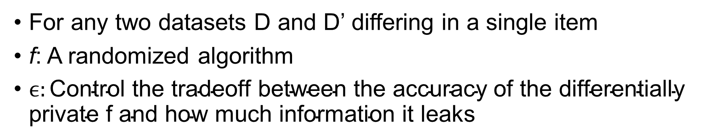
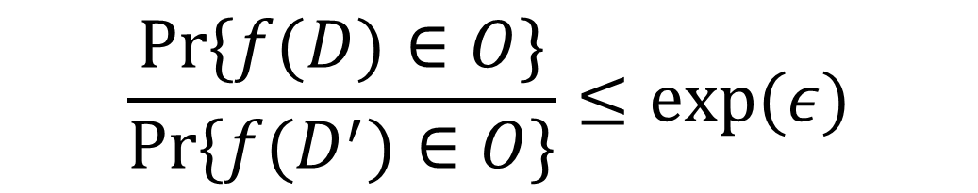
Differential Privacy
Probability distribution
How to implement differential privacy?
$$\frac{Pr⁡\{f(D)∈O\}}{Pr⁡\{f(D^{′})∈O\}}≤exp⁡(ε)$$
One approach is adding noise from Laplace distribution
For any two datasets D and D’ differing in a single item
f: A randomized algorithm
$ϵ:\text{C}\text{ontrol} \text{the} \text{tradeoff} \text{between} \text{the} \text{accuracy} \text{of} \text{the} \text{differentially} \text{private} \text{f} \text{and} \text{how} \text{much} \text{information} \text{it} \text{leaks}$
We hope the attacker can not find any method T to recognize the result of D and D’
T
f(D)
f(D’)
Notes:
f: computes parameter gradients and selects which of them to share with other participants.
For any two datasets D and D 0 differing in a single item

Slide 16
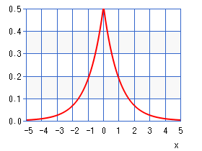
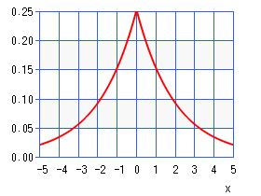
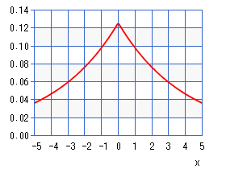
Differential Privacy
Generate a random noise r_{τ} from the Laplace distribution
bound(∆w, γ) : enforces ∆w to be in range [γ,-γ] (truncates ∆w if outside the range)
Select a gradient ∆w
Server
Generate a random noise r_{w} from the Laplace distribution whose scale (standard deviation) is two times larger than the distribution in step 1
No
global parameter
If abs(bound(∆w, γ)) + r_{w} ≥ τ + r_{τ}
γ : Bound on gradients shared with other clients. It can be set by the clients
τ: Threshold for gradient selection. It can be set by the clients
Add noise to gradients!
Select a gradient
Upload bound(∆w + r’_{w} , γ)
比較胖
Yes
Generate a random noise r’_{w} from the Laplace distribution whose scale is four times larger than the distribution in step 1
更胖
Upload bound(∆w + r’_{w} , γ) to the parameter server

Slide 17
Experiments

Slide 18
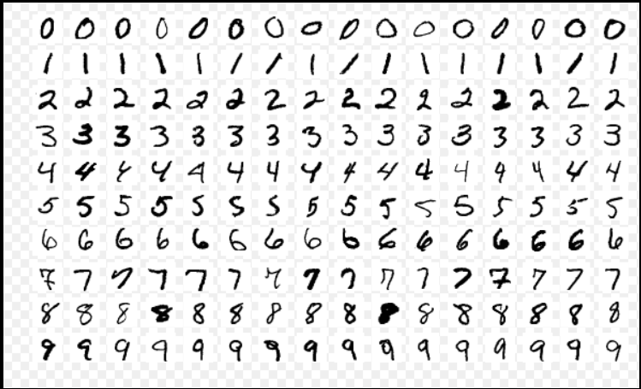
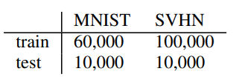
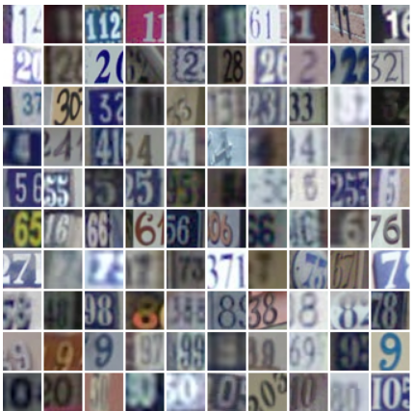
Datasets
MNIST
Handwritten digits formatted
32x32 images
10 classes (0~9)
SVHN
House numbers
32x32 images
10 classes (0~9)
RGB color information covert to YUV

Slide 19
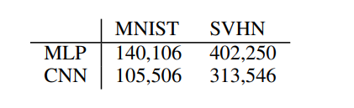
Neural Network Architectures
Use Torch7 nn packages
MLP
CNN

Slide 20
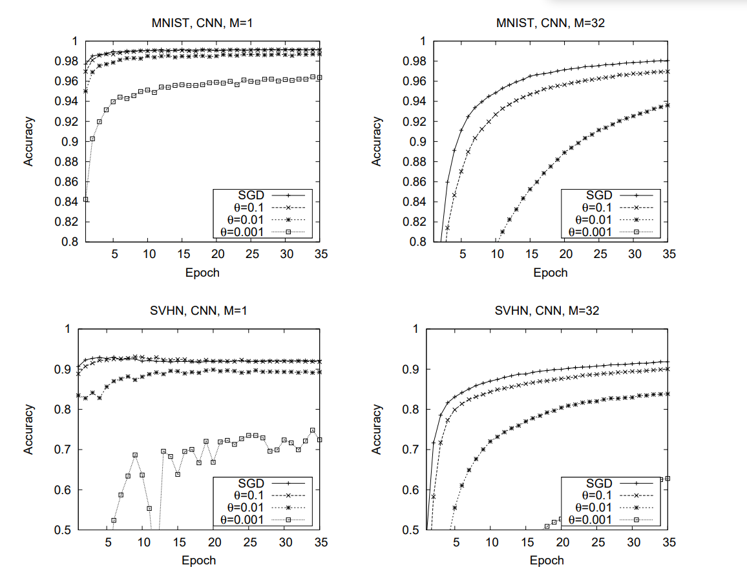
Accuracy for Different Batch Sizes (Round-Robin)
M: batch size
θ_{u}: fraction of parameters for upload
SGD: All training data is pooled for centralized training
(server直接拿所有training data來訓練)
The fraction of parameters for download is always set to 1 in the experiments of this paper
Batch size M=1時，當上傳的gradient比較少時（θ_{u}小），收斂比較慢
Notes:
不同upload fraction 及 batch size

Slide 21
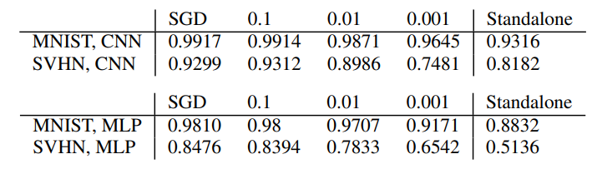
Different Architectures and Parameter Sharing Rates
θ
Batch size M = 1
Standalone: Use only local data to train local model

Slide 22
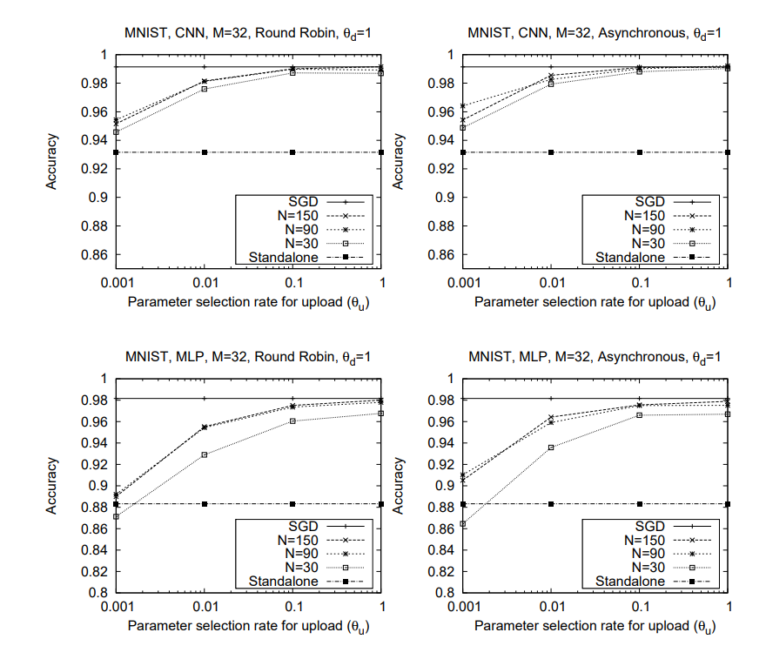
Different Exchange Protocols and # Participants
M: batch size
N: number of participants
θ_{u}: fraction of parameters for upload
θ_{d}: fraction of parameters for download
SGD: All training data is pooled for centralized training.
Standalone: Each participants trains independently on his own data
Notes:
不同number of participants和exchange protocol比較

Slide 23
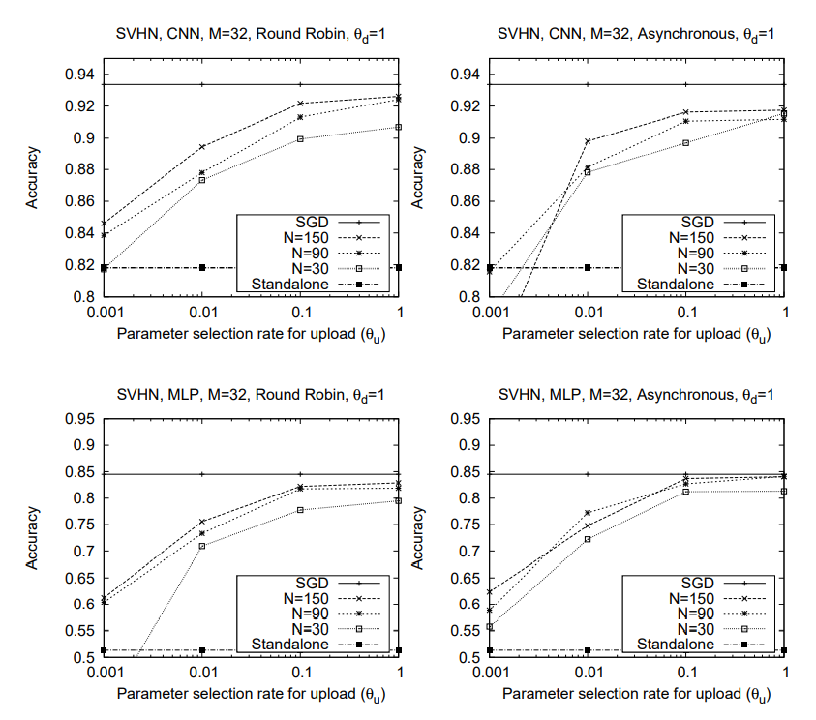
Different Exchange Protocols and # Participants
M: batch size
N: number of participants
θ_{u}: fraction of parameters for upload
θ_{d}: fraction of parameters for download
SGD: All training data is pooled for centralized training.
Standalone: Each participants trains independently on his own data
Notes:
不同number of participants和exchange protocol比較

Slide 24
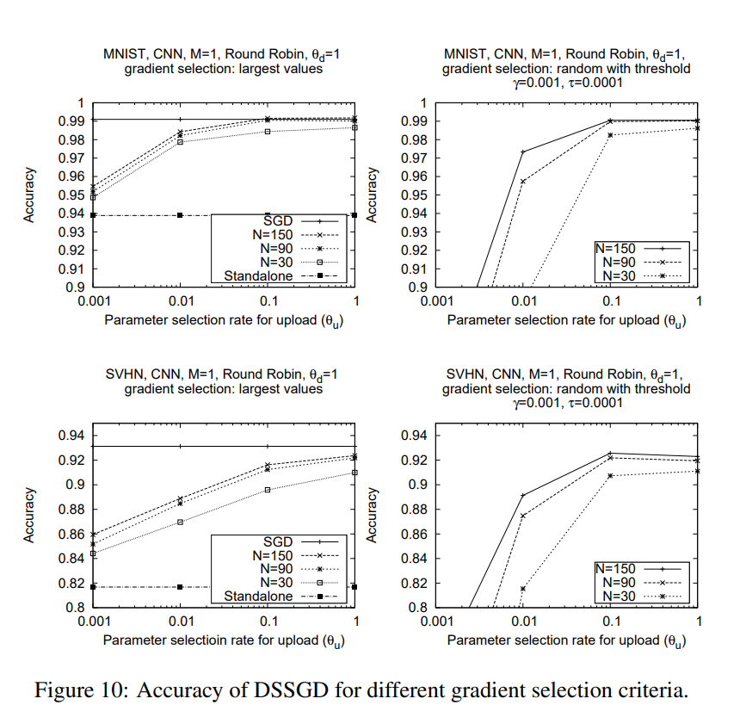
Different Gradient Selection Criteria
Largest values:
Sort gradients and select starting from the biggest.
Random with threshold:
γ: bound on gradients shared with other clients
τ: threshold for gradient selection. It can be set by the clients
Truncate gradient values ∆w into the [−0.001, 0.001] ([γ, - γ])
Upload if abs(∆w) ≥ τ = 0.0001
Batch size M = 1
Notes:
gradient選擇方式的不同比較

Slide 25
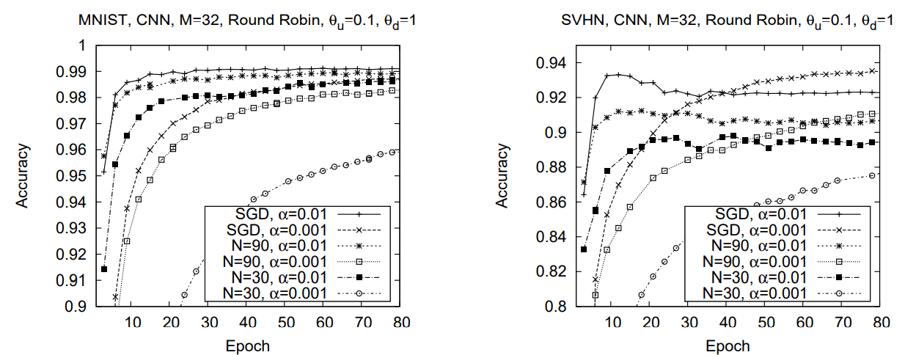
Different # Participants and Learning Rate
M: batch size
N: number of participants
α: learning rate
θ_{u}: fraction of parameters for upload
θ_{d}: fraction of parameters for download
We’re also interested in the comparisons of DSSGD with Standalone (training independently with local data)
We conducted extra experiments on this!
Notes:
不同的participants數量和learning rate組合

Slide 26
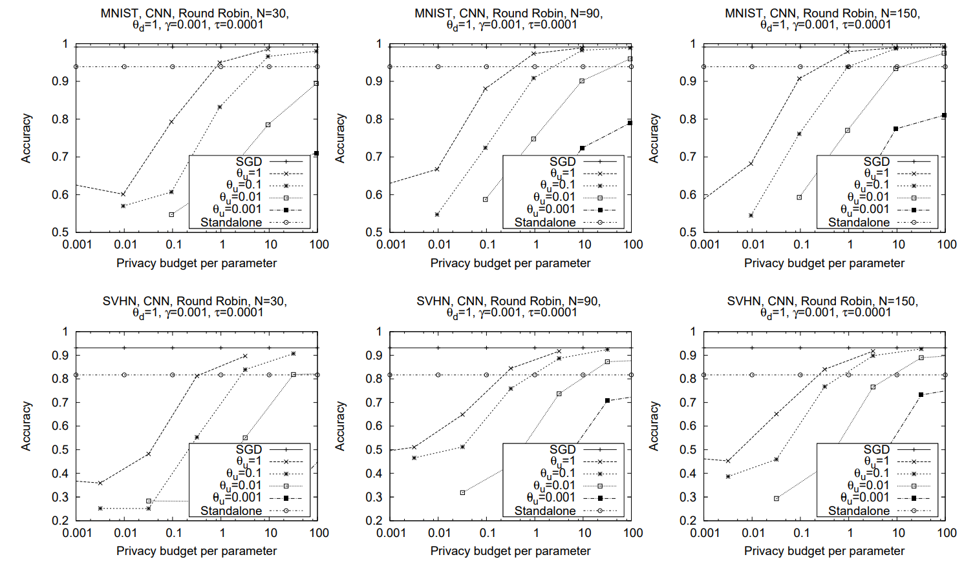
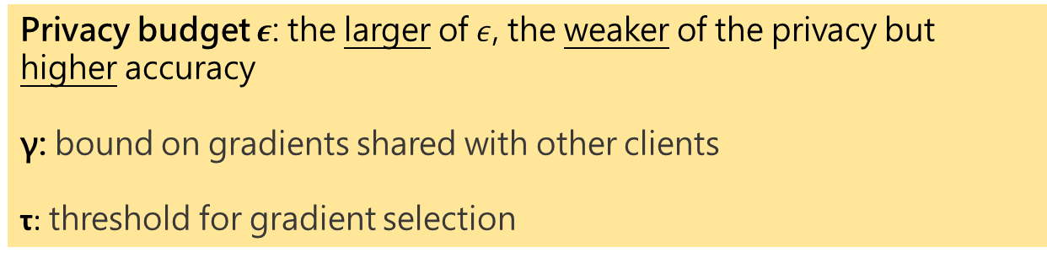
Differential Privacy
Privacy budget $ε$: the larger of $ε$, the weaker of the privacy but higher accuracy
γ: bound on gradients shared with other clients
τ: threshold for gradient selection
Notes:
Privacy experiments
As expected, smaller values (i.e., stronger differential privacy guarantees) result in lower accuracy

Slide 27
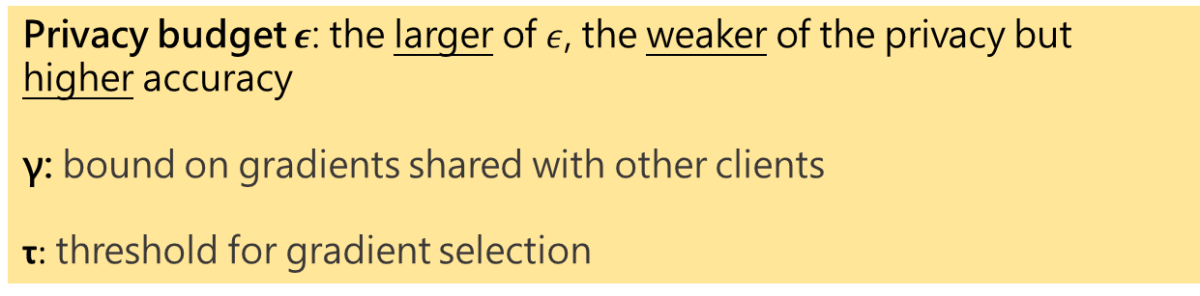
Differential Privacy
Privacy budget $ε$: the larger of $ε$, the weaker of the privacy but higher accuracy
γ: bound on gradients shared with other clients
τ: threshold for gradient selection
Notes:
Privacy experiments
As expected, smaller values (i.e., stronger differential privacy guarantees) result in lower accuracy

Slide 28
Additional Experiments Performed by us
- We implemented DSSGD to:
1) Understand it more clearly
2) Answer a set of questions raised by ourselves

Slide 29
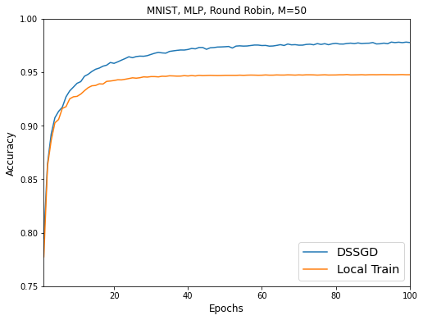
Different Training Epochs
在Round Robin的機制下，去比較Local Train和DSSGD的準確率。
Local Train: 總共60,000筆的training data切成10份 (10 participants)，分給每個參與的機構，每個參與機構用自己所分到的6,000筆的training data去訓練。
DSSGD: 用這邊論文的方法，每個參與機構用local training data每訓練完1個epoch，就上傳梯度去更新。
兩者test data都是用同一份總共10,000筆的資料去看其accuracy,並且各做10次取平均。
可以發現只用local data去train的方法，在epoch = 20左右就已經收斂，準確率不再上升；但DSSGD還是有一直往global optimum去找。
Batch size M = 50
# participants = 10
Fraction of parameters for download = 1
Fraction of parameters for upload = 1
Notes:
Exchange protocol的比較
要多一些epoch (100)
以及local train是怎麼取
這張圖用意是什麼
這邊是上傳parameters，因為這篇paper是做upload gradients，所以我們想看上傳parameters時的表現會如何
因為paper裡面直接比accuracy，我們想知道在round robin下模型收斂的情況，所以我們去做實驗看看和local train相比會是什麼情形

Slide 30
Asynchronous Exchange Protocol
m: m participants download parameter at the same time
e.g., assume m = 3, N=10:
P1
P2
P3
P4
P5
P6
P7
P8
P9
P10
P2 uploads parameters to server and finishes it
P10 uploads parameters to server and finishes it
P1 uploads parameters to server and finishes it
P3 uploads parameters to server and finishes it
P8 uploads parameters to server and finishes it
P6 uploads parameters to server and finishes it
P9 uploads parameters to server and finishes it
P4 uploads parameters to server and finishes it
P7 uploads parameters to server and finishes it
P5 uploads parameters to server and finishes it
P10 does local training
P10 download parameters
P1, P2, and P3 download parameters at the same time
P4, P5, and P6 download parameters at the same time
P7, P8, and P9 download parameters at the same time
P1, P2, and P3 do local training
P4, P5, and P6 do local training
P7, P8, and P9 do local training
: Original model
: Download parameter from server
: Local training
: Upload parameters to server and finish
Notes:
Exchange protocol的比較
講清楚m是什麼 前面就先講
做10次取平均

Slide 31
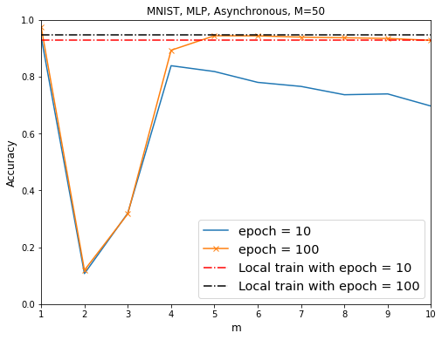
Asynchronous Exchange Protocol
用DSSGD的方法，在不同步的機制下，去看不同的m值對應到的準確率為何，圖上的準確率都是做10次後取平均的結果。
m=1時，其實就等同於round robin，所以準確率會是最高。而在不同步的機制下，準確率會受到影響，但當epoch提高後，準確率還是會上升，不過跟local train比起來，準確率是差不多的。另外在m=2和3時，就算提高epoch也還是沒有提高準確率。原因可能是因為m過小，每個人download到的模型參數相差越多，有些是經訓練過比較好的，有些是比較差的，那上傳的gradient差異過大，那就有可能會把Server的參數調差，最後global model的performance甚至比只用local data去訓練還差。
Batch size m = 50
# participants = 10
Fraction of parameters for download = 1
Fraction of parameters for upload = 1
Round Robin
Notes:
Exchange protocol的比較
講清楚m是什麼 前面就先講
做10次取平均

Slide 32
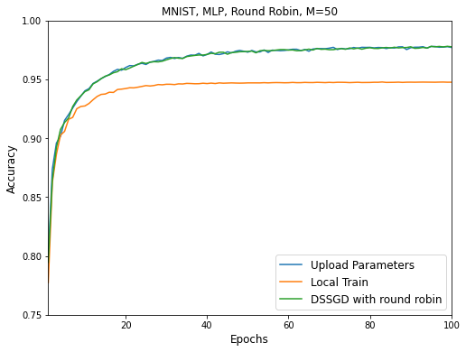
Parameter Upload
在Round Robin的機制下，取代原本上傳梯度的方法，直接上傳模型的參數，去和Local Train及DSSGD的方法比較，看準確率會不會有差。
三者test data都是用同一份總共10,000筆的資料去看其accuracy,並且各做10次取平均。可以發現直接上傳參數，其實就和DSSGD是差不多的，兩者都能繼續往global optimum去找，但Local Train就會容易卡在local optimum。
Batch size m = 50
# participants = 10
Fraction of parameters for download = 1
Fraction of parameters for upload = 1
Notes:
Exchange protocol的比較
10次平均
Epoch 100

Slide 33
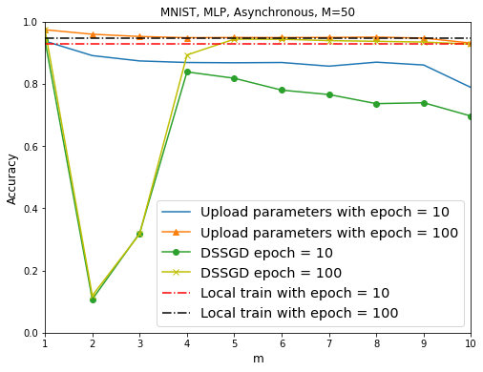
Uploading Parameters Asynchronously
在不同步的機制下，比較DSSGD和直接上傳參數兩種方法，分別在不同m值對應到的準確率為何，圖上的準確率都是做10次後取平均的結果。
可以發現若直接上傳參數，在不同步的機制下，跟DSSGD相比起來，比較不會受到影響，但是當m越大時，準確率會有下降的趨勢，推測是因為上傳參數是直接把Server上的參數overwrite，假如當m=10，10個人同時下載Server上的參數，再分別上傳，但因為是直接overwrite參數，所以其實最後Server上的參數就只有最後一個上傳的人用local dataset訓練完的效果。
Batch size m = 50
# participants = 10
Fraction of parameters for download = 1
Fraction of parameters for upload = 1
m: m participants download the parameters simultaneously
Round Robin
Notes:
Exchange protocol的比較
10次平均

Slide 34
Inverting Gradients - How easy is it to break privacy in federated learning?
Jonas Geiping, Hartmut Bauermeister, Hannah Dröge
NeurIPS
2020

Slide 35
Contribution
Reconstruction of input data from gradient information is possible for realistic deep and non-smooth architectures.
With the right attack, there is little “defense-in-depth" - deep networks are as vulnerable as shallow networks.
It prove that the input to any fully connected layer can be reconstructed analytically independent of the remaining network architecture.

Slide 36
Federated Learning (Horizontal)
Aggregate
parameter
data
parameter
Private Data
Local Model
data
gradients
gradients
Local Model
Private Data
parameter
data
gradients
Private Data
Local Model
Notes:
多一兩頁去做vertical

Slide 37
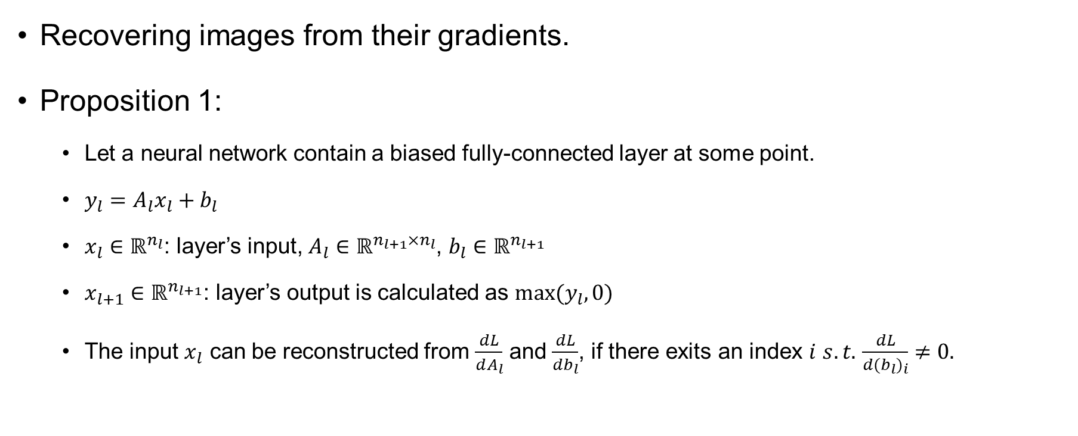
Theoretical Analysis
Recovering images from their gradients.
Proposition 1:
Let a neural network contain a biased fully-connected layer at some point.
$y_{l}=A_{l}x_{l}+b_{l}$
$x_{l}∈ℝ^{n_{l}}$: layer’s input, $A_{l}∈ℝ^{n_{l+1}×n_{l}}$, $b_{l}∈ℝ^{n_{l+1}}$
$x_{l+1}∈ℝ^{n_{l+1}}$: layer’s output is calculated as $max⁡(y_{l},0)$
The input $x_{l}$ can be reconstructed from $\frac{dL}{dA_{l}}$ and $\frac{dL}{db_{l}}$, if there exits an index $i$ $s.t.$ $\frac{dL}{d{(b}_{l})_{i}}≠0.$

Slide 38
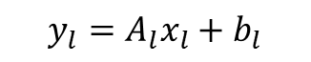
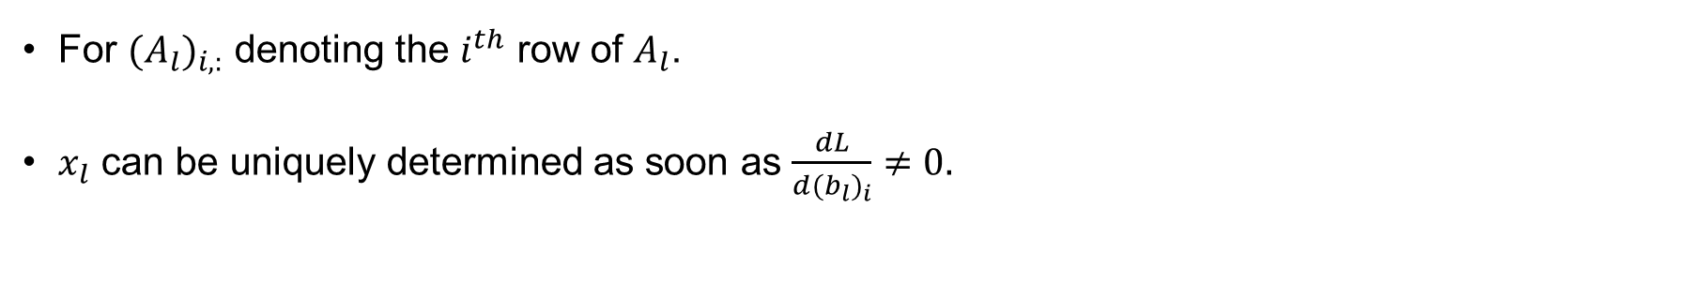
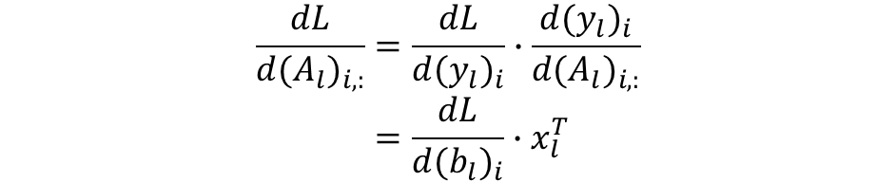
Theoretical Analysis
Proof: it holds that $\frac{dL}{d{(b}_{l})_{i}}=\frac{dL}{d{(y}_{l})_{i}}$ and $\frac{dy_{i}}{d{(A}_{l})_{i, :}}=x_{l}^{T}$
$$y_{l}=A_{l}x_{l}+b_{l}$$
$$\frac{dL}{d{(A}_{l})_{i,:}}=\frac{dL}{d{(y}_{l})_{i}}∙\frac{d{(y}_{l})_{i}}{d{(A}_{l})_{i,:}} \\ =\frac{dL}{d{(b}_{l})_{i}}∙x_{l}^{T}$$
For ${(A}_{l})_{i,:}$ denoting the $i^{th}$ row of $A_{l}$.
$x_{l}$ can be uniquely determined as soon as $\frac{dL}{d{(b}_{l})_{i}}≠0.$

Slide 39
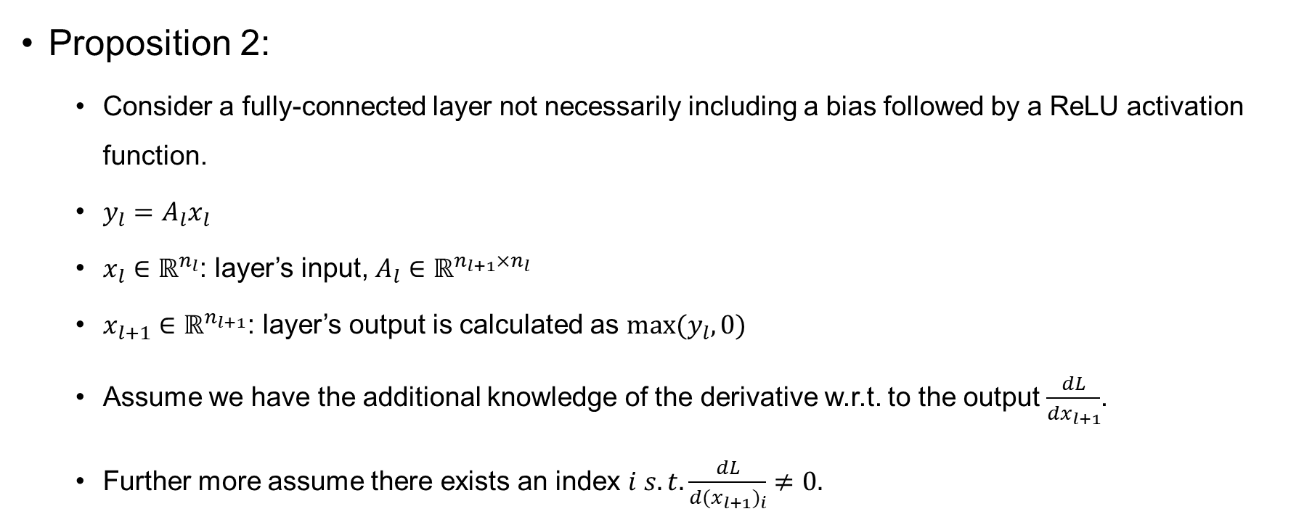
Theoretical Analysis
Proposition 2:
Consider a fully-connected layer not necessarily including a bias followed by a ReLU activation function.
$y_{l}=A_{l}x_{l}$
$x_{l}∈ℝ^{n_{l}}$: layer’s input, $A_{l}∈ℝ^{n_{l+1}×n_{l}}$
$x_{l+1}∈ℝ^{n_{l+1}}$: layer’s output is calculated as $max⁡(y_{l},0)$
Assume we have the additional knowledge of the derivative w.r.t. to the output $\frac{dL}{dx_{l+1}}$.
Further more assume there exists an index $i s.t.\frac{dL}{d{(x}_{l+1})_{i}}≠0.$

Slide 40
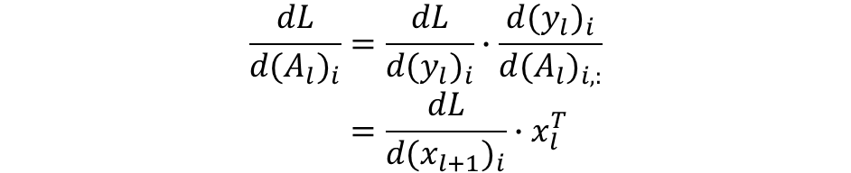
Theoretical Analysis
Proof: as $\frac{dL}{d{(x}_{l+1})_{i}}≠0$ it holds that $\frac{dL}{d{(y}_{l})_{i}}=\frac{dL}{d{(x}_{l+1})_{i}}$
$$\frac{dL}{d{(A}_{l})_{i}}=\frac{dL}{d{(y}_{l})_{i}}∙\frac{d{(y}_{l})_{i}}{d{(A}_{l})_{i,:}} \\ =\frac{dL}{d{(x}_{l+1})_{i}}∙x_{l}^{T}$$
For ${(A}_{l})_{i,:}$ denoting the $i^{th}$ row of $A_{l}$.
$x_{l}$ can be uniquely determined as soon as $\frac{dL}{d{(b}_{l})_{i}}≠0.$

Slide 41
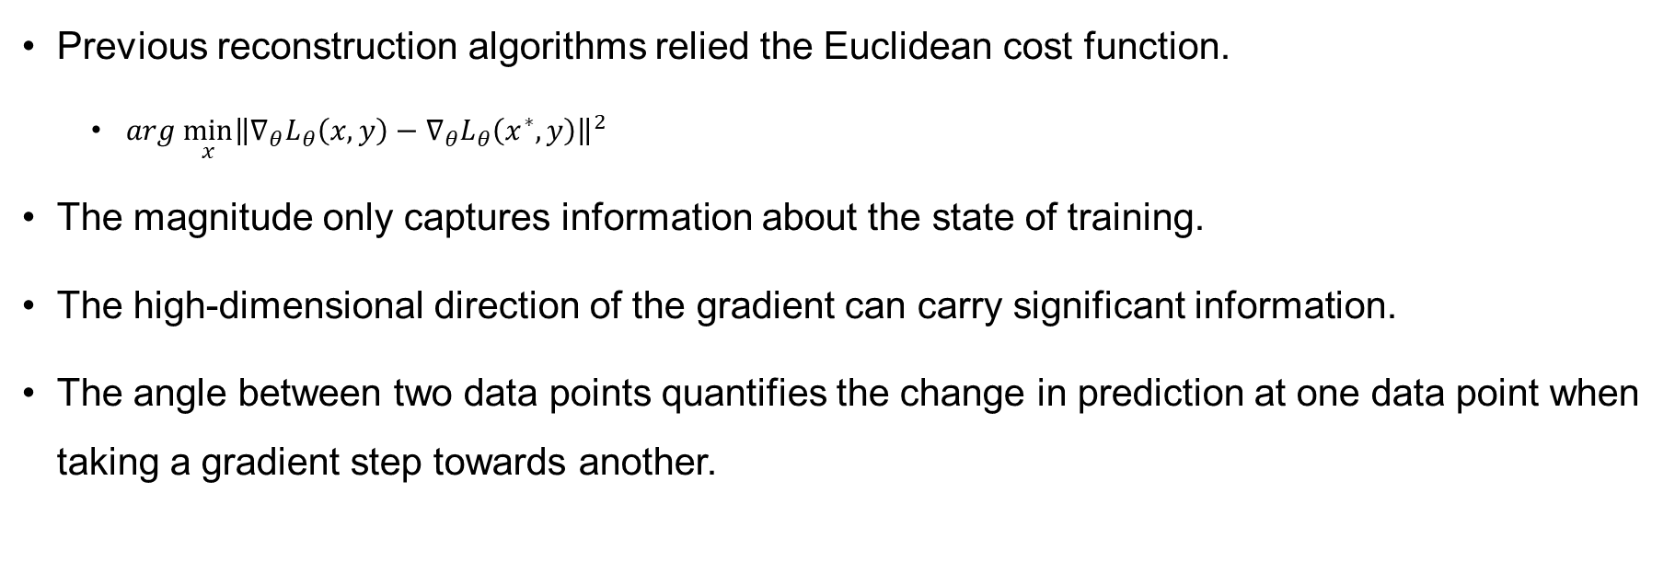
Numerical Reconstruction Method
Previous reconstruction algorithms relied the Euclidean cost function.
$arg \min_{x}{{\left\|∇_{θ}L_{θ}\left(x,y\right)−∇_{θ}L_{θ}\left(x^{∗},y\right)\right\|}^{2}}$
The magnitude only captures information about the state of training.
The high-dimensional direction of the gradient can carry significant information.
The angle between two data points quantifies the change in prediction at one data point when taking a gradient step towards another.

Slide 42
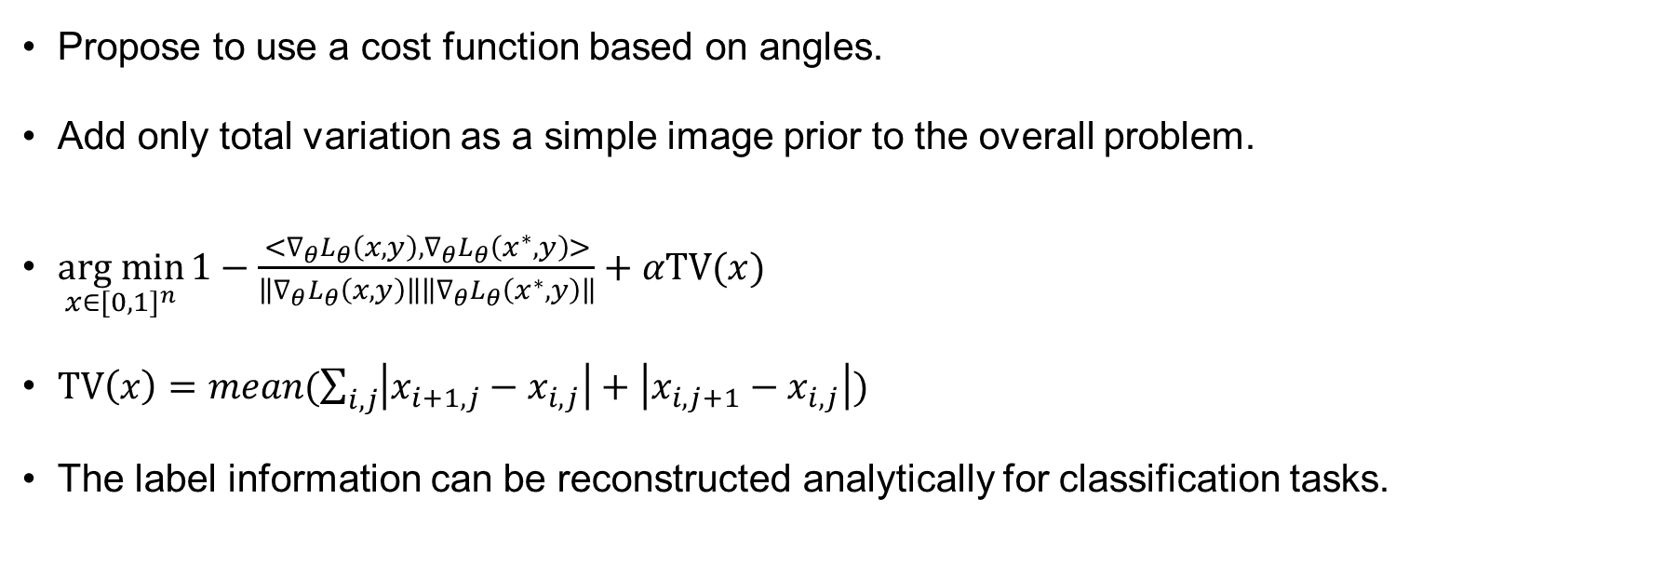
Numerical Reconstruction Method
Propose to use a cost function based on angles.
Add only total variation as a simple image prior to the overall problem.
$\underset{x∈[{0,1]}^{n}}{arg min}{1}−\frac{<∇_{θ}L_{θ}\left(x,y\right),∇_{θ}L_{θ}\left(x^{∗},y\right)>}{\left\|∇_{θ}L_{θ}\left(x,y\right)\right\|\left\|∇_{θ}L_{θ}\left(x^{∗},y\right)\right\|}+αTV(x)$
$TV\left(x\right)=mean(\sum_{i,j}{\left|x_{i+1,j}−x_{i,j}\right|+\left|x_{i,j+1}−x_{i,j}\right|})$
The label information can be reconstructed analytically for classification tasks.
Notes:
TV: total variation，一個訊號處理的方式(signal processing)，這個又特別會用在影像處理，可以降低影像中noise的干擾，移除image中的noise
因為相鄰的pixel

Slide 43
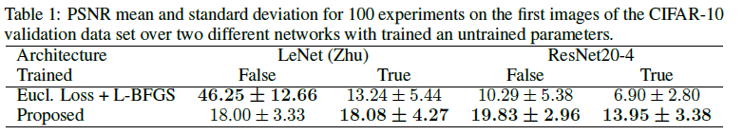
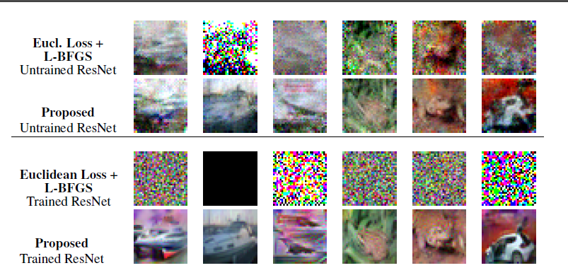
Single Image Reconstruction from a Single Gradient
Comparison to previous approaches:
Notes:
In fig2, Interestingly, the reconstructions on the trained ResNet have a better visual quality than those of the untrained ResNet, despite their lower PSNR values according to table 1.

Slide 44
Single Image Reconstruction from a Single Gradient
If a network is trained and has sufficient capacity for the gradient of the loss function L to be zero for different inputs, it is obvious that they can never be distinguished from their gradient.
In practical settings, the gradient of images is rarely entirely zero.
Image gradients have a much smaller magnitude in a trained network than in an untrained one.
Notes:
In fig2, Interestingly, the reconstructions on the trained ResNet have a better visual quality than those of the untrained ResNet, despite their lower PSNR values according to table 1.

Slide 45
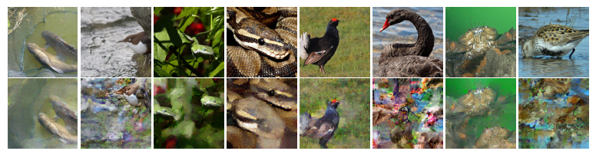
Single Image Reconstruction from a Single Gradient
Although the overall privacy of most images is clearly breached, this effect at least obstructs the recovery of fine scale details or the image’s background.
Data augmentation used during the training of neural networks leads to trained networks that make the localization of objects more difficult.
Notes:
有用data augmentation的話產生出來圖片的位置會比較不一樣 可以看這隻蛇的照片

Slide 46
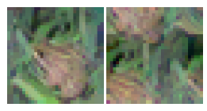
Translational Invariant Convolutions
Conventional convolutional neural network: convolution with zero-padding (left).
Translationally invariant CNN: convolutions with circular padding (right).
Common zero-padding as a source of privacy risk.
Notes:
CNN padding的方式不同，還原出來的效果就也比較不一樣，用 zero-padding 的方式會跟原圖比較接近

Slide 47
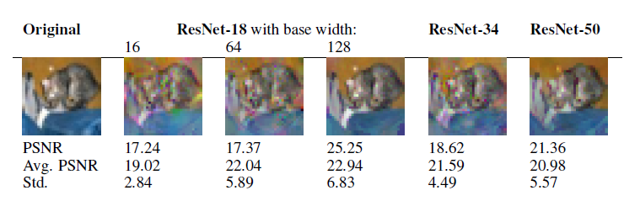
Network Depth and Width
Larger network width is also accompanied with an increasing variance of experimental success.
Greater network width increases the computational effort of the attacker, but does not provide greater security.
The proposed attack degrades very little with an increased depth of the network.
Notes:
攻擊的效果不會因為模型深度受影響

Slide 48
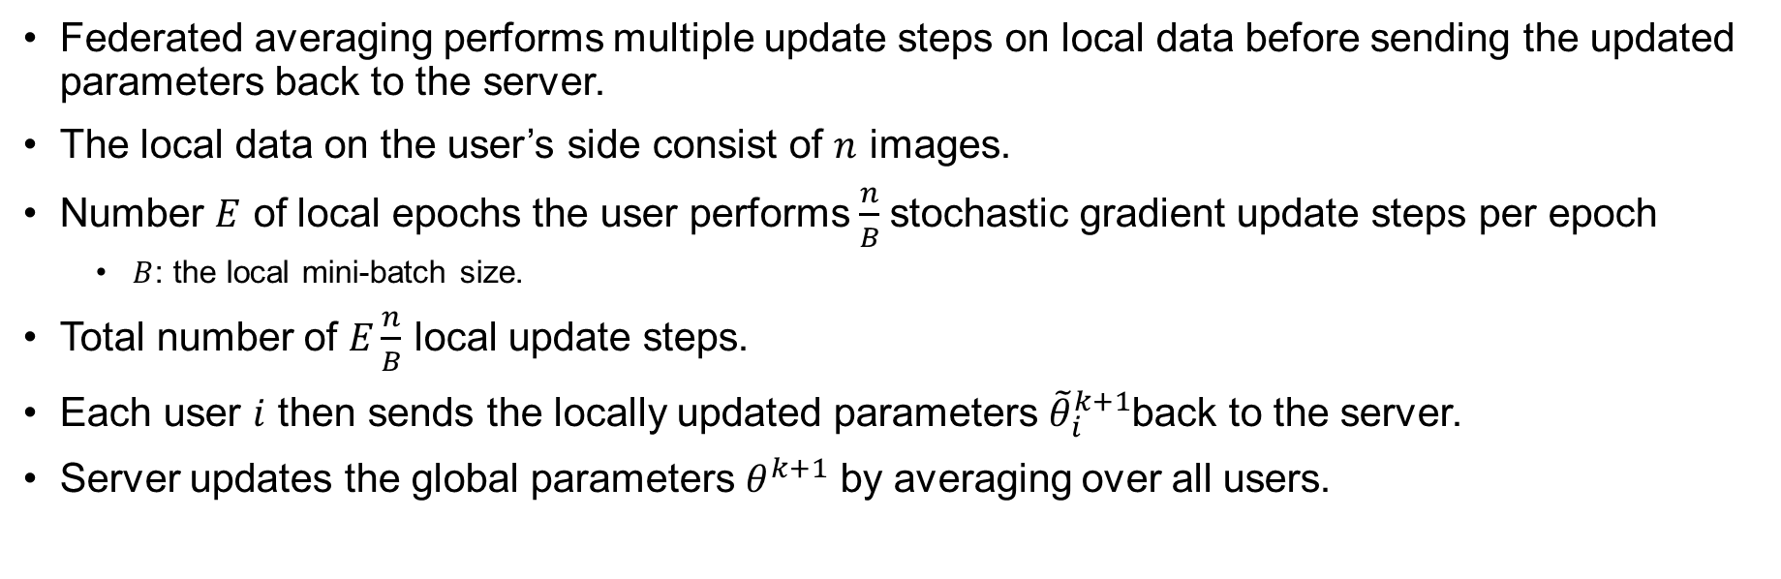
Federated Averaging and Multiple Images
Federated averaging performs multiple update steps on local data before sending the updated parameters back to the server.
The local data on the user’s side consist of $n$ images.
Number $E$ of local epochs the user performs $\frac{n}{B}$stochastic gradient update steps per epoch
$B$: the local mini-batch size.
Total number of $E\frac{n}{B}$ local update steps.
Each user $i$ then sends the locally updated parameters ${\tilde{θ}}_{i}^{k+1}$back to the server.
Server updates the global parameters $θ^{k+1}$ by averaging over all users.

Slide 49
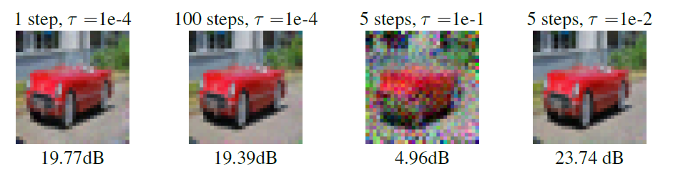
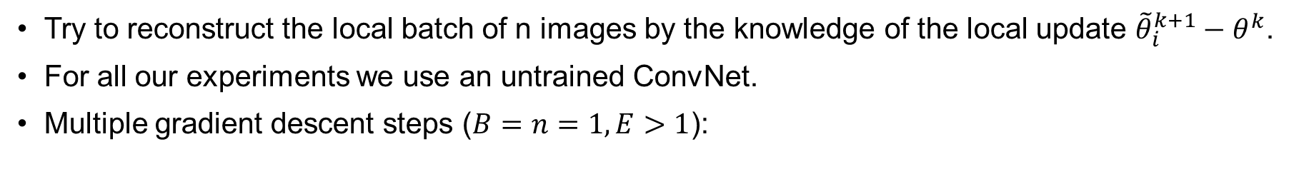
Federated Averaging and Multiple Images
Try to reconstruct the local batch of n images by the knowledge of the local update ${\tilde{θ}}_{i}^{k+1}−θ^{k}$.
For all our experiments we use an untrained ConvNet.
Multiple gradient descent steps ($B=n=1, E>1$):
Notes:
The left two images compare the influence of the number of gradient descent steps
for a fixed learning rate of =1e-4. The two images on the right result from varying the learning rate
for a fixed number of 5 gradient descent steps. PSNR values are shown below the images.
Figure

Slide 50
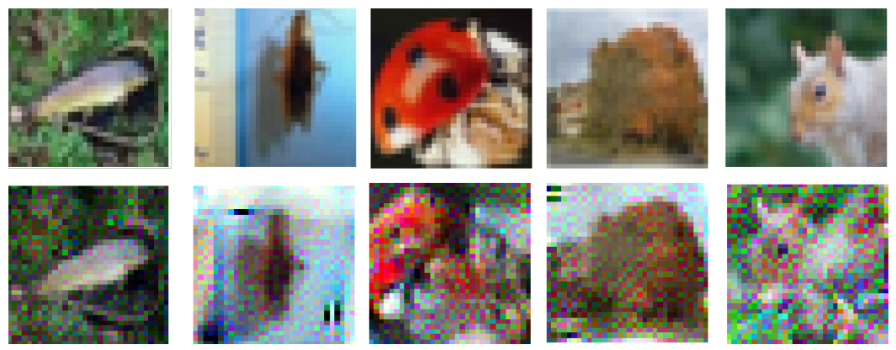
Federated Averaging and Multiple Images
Multi-Image Recovery ($B=n>1, E=1$):
Batch size = 100.
Notes:
Information leakage from the aggregated gradient of a batch of 100 images on CIFAR-100
for a ResNet32-10. Shown are the 5 most recognizable images from the whole batch. Although
most images are unrecognizable, privacy is broken even in a large-batch setting. We refer to the
supplementary material for all images.

Slide 51
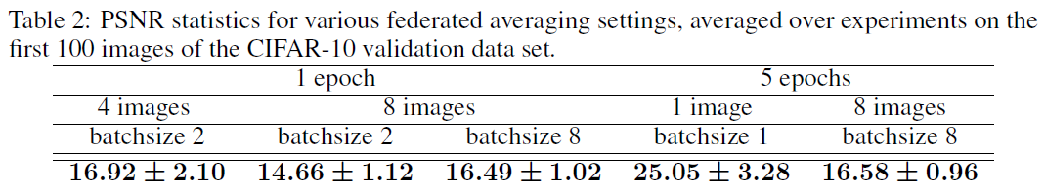
Federated Averaging and Multiple Images
General case: multiple local updates steps using a subset of the whole local data in each mini batch gradient step.
Notes:
the single image reconstruction turns out to be most amenable to attacks in terms of PSNRs values.

Slide 52
A Coupled Design of Exploiting Record Similarity for Practical Vertical Federated Learning
Zhaomin Wu, Qinbin Li, Bingsheng He
NeurIPS
2022

Slide 53
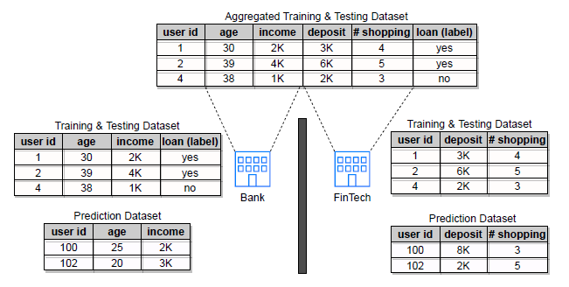
Recall: Vertical Federated Learning (VFL)
Same set of sample while each party only has a disjoint subset of features.
Identifier: the vector of common features in a data record.
Primary party: the party with the label
Second parties: other parties

Slide 54
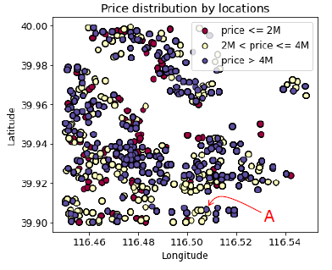
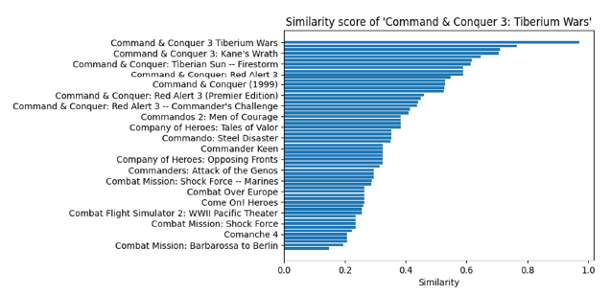
Observation 1
Only linking the records with top similarity does not necessarily capture the key feature.
Linked by GPS locations of houses, the closet house to house A may not be in the same price level.
Linking not only the exactly matched game but also other games in the same series intuitively benefits game recommendation tasks.

Slide 55
Observation 2
Existing studies formulate VFL as to separated processes: linkage and training.
Separating the linkage from the training also harms the performance of VFL.
The linkage process cannot obtain any feedback from the training process.

Slide 56
Issues
Exactly matched
If some features are missing or biased, one-to-one linkage prevents the training process from enhancing these features from other similar.
One-to-all keeps all the information but is too expensive for both linkage and training.
Separated process
Separating the linkage from the training harms the performance of VFL.
The linkage is conducted with the goal of find true-matched pairs of records instead of finding the pairs that reduce the training loss.

Slide 57
Contribution
Design a coupled framework FedSim of linkage and training based on similarity.
Add Gaussian noise to the similarities for privacy preserving.
Conduct extensive experiments on synthetic datasets and real-world datasets, which indicates that FedSim outperforms state-of-the-art baseline.

Slide 58
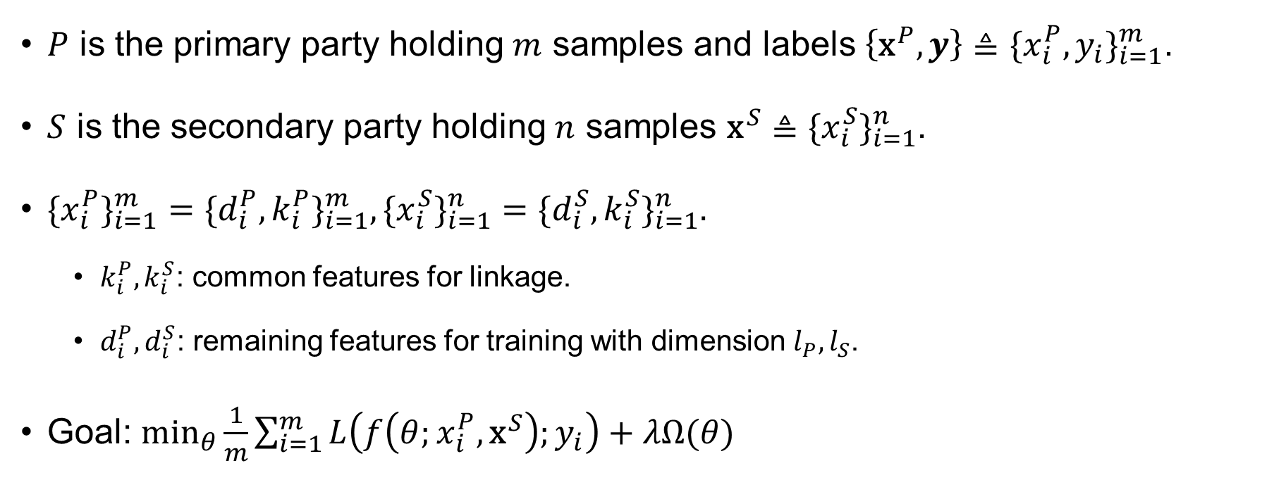
Definition
$P$ is the primary party holding $m$ samples and labels $\left\{{\text{x}}^{P}, y\right\}≜\{x_{i}^{P},y_{i}\}_{i=1}^{m}$.
$S$ is the secondary party holding $n$ samples ${\text{x}}^{S}≜\{x_{i}^{S}\}_{i=1}^{n}$.
$\{x_{i}^{P}\}_{i=1}^{m}=\{d_{i}^{P},k_{i}^{P}\}_{i=1}^{m},\{x_{i}^{S}\}_{i=1}^{n}=\{d_{i}^{S},k_{i}^{S}\}_{i=1}^{n}.$
$k_{i}^{P},k_{i}^{S}$: common features for linkage.
$d_{i}^{P},d_{i}^{S}$: remaining features for training with dimension $l_{P}, l_{S}$.
Goal: $\min_{θ}{\frac{1}{m}\sum_{i=1}^{m}{L\left(f\left(θ;x_{i}^{P},{\text{x}}^{S}\right);y_{i}\right)+λΩ(θ)}}$

Slide 59
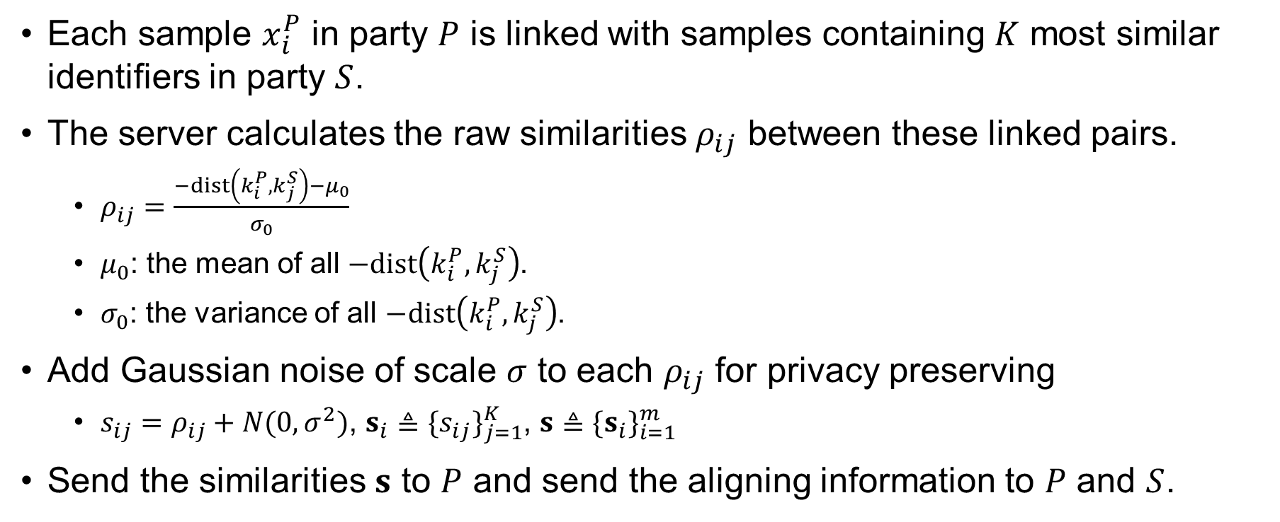
Soft Linkage
Each sample $x_{i}^{P}$ in party $P$ is linked with samples containing $K$ most similar identifiers in party $S$.
The server calculates the raw similarities $ρ_{ij}$ between these linked pairs.
$ρ_{ij}=\frac{−dist\left(k_{i}^{P},k_{j}^{S}\right)−μ_{0}}{σ_{0}}$
$μ_{0}$: the mean of all $−dist\left(k_{i}^{P},k_{j}^{S}\right)$.
$σ_{0}$: the variance of all $−dist\left(k_{i}^{P},k_{j}^{S}\right)$.
Add Gaussian noise of scale $σ$ to each $ρ_{ij}$ for privacy preserving
$s_{ij}=ρ_{ij}+N(0,σ^{2})$, $s_{i}≜\{s_{ij}\}_{j=1}^{K}$, $s≜\{s_{i}\}_{i=1}^{m}$
Send the similarities $s$ to $P$ and send the aligning information to $P$ and $S$.

Slide 60

SplitNN
Split a model into multiple parties.
Conduct training by transferring gradients and intermediate outputs.
Concatenating the outputs of local models.

Slide 61


Similarity-Based VFL
Weight Gate
The rows in $o_{i}$ with higher similarities should be granted a larger weight.
The values of similarities do not directly represent the importance of records.
Use a simple neural network to non-linearly map the similarities to weights $w_{i}$.

Slide 62

Similarity-Based VFL
Sort Gate
Inconsistent order of features can incur irregular sharp gradients.
It makes the merge model hard to converge.
Sort the rows of $o_{i}^{′}$ by $s_{i}$ or $w_{i}$.

Slide 63

Similarity-Based VFL
Merge Gate
Aggregate the information in $o_{i}^{′}$.
The merge model can be implemented by a MLP, but usually leads to over-fitting.
The merge model is unaware of which $K$ features in the flattened $o_{i}^{′}$ correspond to the same output feature in $o_{i}^{′}$.

Slide 64

Similarity-Based VFL

Slide 65

Experiment Setting
Synthetic datasets:
sklearn
frog
boone
Real-world datasets
house
taxi
hdb
game
company
Notes:
In house dataset, dataset A contains housing data in Beijing collected from lianjia [42], and dataset B contains
renting data in Beijing collected from Airbnb [1]. Two parties are linked by longitude and latitude and the task is
to predict the housing price.
In taxi dataset, dataset A contains taxi trajectory data in New York from TLC [51],
and dataset B contains bike trajectory data in New York from Citi Bike [3]. Two parties are linked by longitude
and latitude of source and destination of the trajectory and the task is to predict the time of the trajectory
In hdb dataset, dataset A contains HDB resale data in Singapore collected from Housing and Development Board [23],
and dataset B contains recent rankings and locations of secondary schools in Singapore collected from salary.sg
[63]. Two parties are linked by longitude and latitude and the task is to predict the HDB resale prices.
In game dataset, party P contains game data (e.g., prices) and the number of owners (#owners) from
Steam [11]. party S contains game ratings and comments from RAWG [24]. Two parties are linked
by game titles and the task is to classify games as popular (#owners > 20000) or unpopular (#owners
≤ 20000) based on ratings, prices, etc.
In company(song) dataset, party P contains timbre values of songs extracted from million song dataset [6], and party S contains the basic information of songs extracted from FMA dataset [12]. Two parties are linked by the titles of songs and the task is to predict the publication years of songs.

Slide 66



Experiment Setting
Baselines:
Solo: only dataset $d^{P}$ is trained.
Combine: $[d^{P},d^{S}]$ is trained.
FedSim-MLP: the CNN in FedSim is changed to MLP
Top1Sim
Exact
FeatureSim
AvgSim
Notes:
Exact: only link exactly matched or most similar pairs.
AvgSim: the prediction $x_{i}^{P}$ is an average of prediction when linking $x_{i}^{P}$ with $K$ nearest $x_{j}^{S}$.
FeatureSim: the similarity between each pair is appended to the record.

Slide 67

Performance on Real-world Datasets

Slide 68

Performance on Synthetic Datasets
Notes:
FedSim is more robust to the noise on the identifiers. For example, in frog, the accuracy of Top1Sim drops to 84% as σcf = 0.2, while the accuracy of FedSim remains 91

Slide 69

Effect of Hyperparameter K
Notes:
As we expect, the performance of Top1Sim remains steady since the pairs with the largest similarities
remain the same. The performance of AvgSim and FeatureSim drops as K increases since they
cannot handle the redundant data properly. On the contrary, with increasing K, the performance
of FedSim increases and then remains steady, which means FedSim can effectively exploit useful
information in these additional data. In conclusion, FedSim is robust to large K; setting a relatively
large K achieves the best performance for FedSim.

Slide 70

Visualization of the Similarity Model and Merge Model
Notes:
similarity越像他轉換成的weight會越高，weight gate有起到他的作用

